Slide 1
LinFlex (UART mode)
Leopard 1M/2M
v.2.0

Slide 2
LinFlex Overview
LIN Protocol Handler
Standard UART mode
3 operation modes
Initialization
Normal
Sleep
DMA/INTC support
CONTROL STATUS REGISTERS
RX/TX
MESSAGE
BUFFER
Filtering Unit
LIN 1.3/2.0/2.1/J2602 Protocol Handler
LIN TX
LIN RX
Notes:
3 operating modes for power saving and configuration registers lock

Slide 3
LinFlex UART mode
Full-duplex communication
Selectable frame size:
8-bit frame
9-bit frame
16-bit frame
17-bit frame
Selectable parity:
Even
Odd
0
1
4-byte buffer for transmission, 4-byte buffer for reception
12-bit counter for timeout management

Slide 4
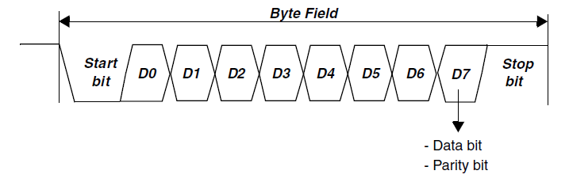
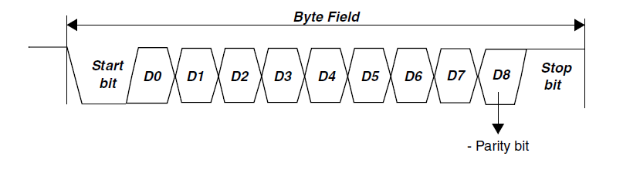
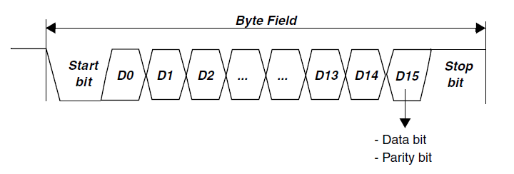
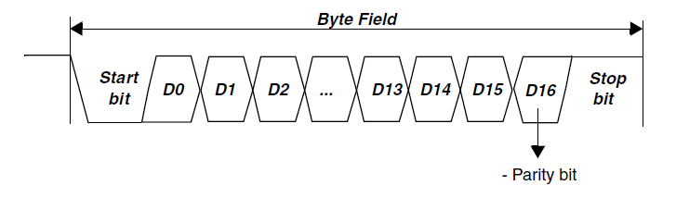
Data frame structure
4 data frame supported
8 bit data frame
9 bit data frame
16 data frame
17 bit data frame

Slide 5
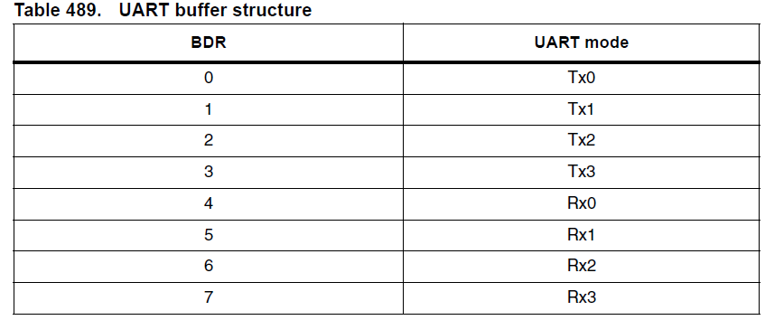
Data buffer
8 bytes data buffer
4 bytes for RX
4 bytes for TX
Configurable
Buffer mode
FIFO mode
Mandatory when DMA RX/TX is enabled
Notes:
In buffer mode the number of data to be sent or received are configured and then written received into the buffer (e.g. to transmit 16bit we write BDR0 and BDR1)
In FIFO mode only BDR0 and BDR4 are visible and the whole buffer is seen as a FIFO

Slide 6
Timeout (a)
A reception timeout is implemented
To avoid reception hanging during not expected condition
The timeout counter:
Starts at zero and counts upward
Is clocked with the baud rate clock prescaled by a hard-wired scaling factor of 16
Is automatically enabled when UARTCR[RXEN] = 1
UART preset timeout register contains the preset timeout value
UARTPTO
UART current timeout register contains the current timeout value in UART mode
UARTCTO
Notes:
Hanging conditions UARTCR[RDFLRFC] is programmed for a certain number of bytes received, but the actual number of bytes received is smaller.

Slide 7
Timeout (b)
Current value of the timeout counter
This field is reset whenever one of the following occurs:
A new value is written to the UARTPTO register
The value of this field matches the value of UARTPTO[PTO]
A reset occurs
New incoming data is received
When timeout expires UARTSR[TO] is set
CTO matches the value of UARTPTO[PTO]
An interrupt is generated on Error interrupt line in UART mode
if enabled by LINIER.DBEIETOIE bit
Notes:
Hanging conditions UARTCR[RDFLRFC] is programmed for a certain number of bytes received, but the actual number of bytes received is smaller.
No interrupt are triggered when the timeout expires.
[AR] Interrupt e’ triggerato se abilitato tramite LINIER.DBEIETOIE

Slide 8
Transmission
Main configuration
UARTCR[UART] is set
Set UARTCR[WLx]
Word length
Set UARTCR[PCE] Parity control enable
Set UARTCR[PC] (Parity control (even, odd, 0, 1))
Set UARTCR[TDFLTFC] field
number of byte to be transmitted in Buffer mode
or number the entry in the FIFO
UARTCR[TXEN] bits set
Transmission starts when BDR0 is programmed
BDR0 is the least significant byte
After the programmed number of bytes has been transmitted the UARTSR[DTFTFF] flag is set
The buffer can be configured in FIFO mode
mandatory when DMA Tx is enabled
UARTCR[TFBM]
Notes:
RXEN bit exists to enable the reception
UARTCR[TDFLTFC] pag.1023 of RM rev.9

Slide 9
Reception (a)
Reception starts as soon as following events occur
Exits Initialization mode
Sets the UARTCR[RXEN] field
Detects the start bit
After the programmed number (RDFL bits) of bytes has been received, the UARTSR[DRFRFE] field is set
The buffer can be configured in FIFO mode
mandatory when DMA Rx is enabled
UARTCR[RFBM]

Slide 10
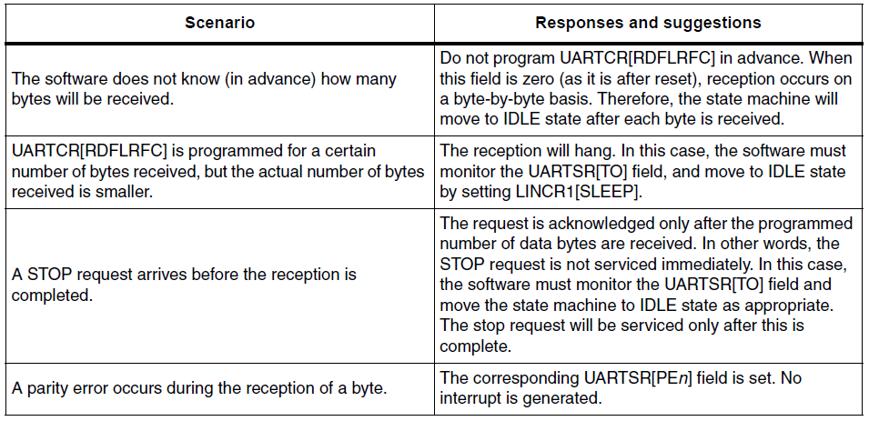
Reception (a)
Typical reception scenarios
Notes:
CLARIFICATION IS NEEDED FOR YOU:In that case, SW needs to take care of timeout by seeing the flag TO or triggering the interrupt. Software has to set the sleep bit to move to idle state

Slide 11
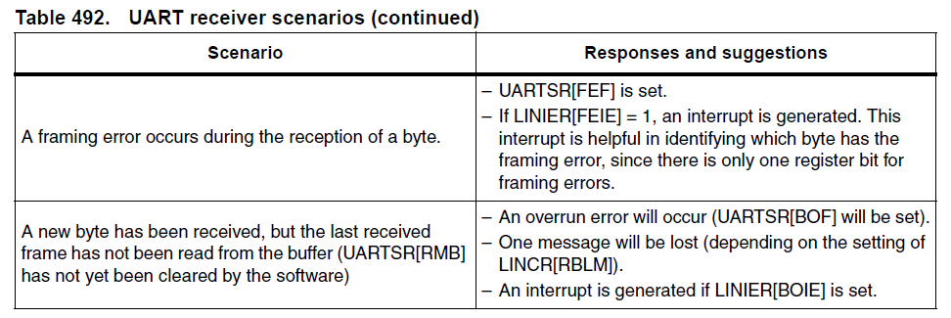
Reception (b)
Typical reception scenarios
Notes:
CLARIFICATION IS NEEDED FOR YOU:In that case, SW needs to take care of timeout by seeing the flag TO or triggering the interrupt. Software has to set the sleep bit to move to idle state

Slide 12

TX/RX Baud rate
The baud rates set as programmed in the Mantissa (LINIBRR) and Fraction (LINFBRR) registers
for both receiver and transmitter
LFDIV is an unsigned fixed point
20 bits for the mantissa (LINIBRR)
4 bits for the fractional part (LINFBRR)
Example: LFDIV = 25.62
Mantissa = 25 -> LINIBRR = 25
Fractional part = 0.62 -> LINFBRR = 10
0.62 * 2^4 = 9.92 ~10

Slide 13
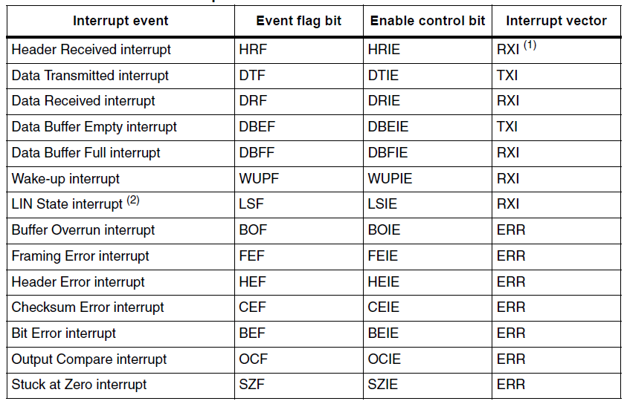
Interrupt
Notes:
RM pag.1025
Framing error means invalid stop bit

Slide 14
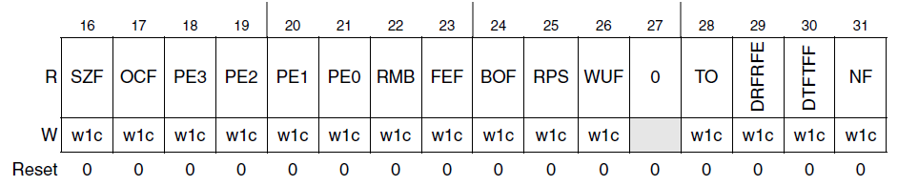
Interrupt
UARTSR
Timeout interrupt is missing in this table (doc error)
Notes:
RM pag.1025
Framing error means invalid stop bit

Slide 15
DMA
Interface to “connect” 2 DMA channels
TX fifo
RX fifo
Notes:
Examples in RM ver.9 pag 1055

